Slide 1
Towards Rich, Portable, and Large-Scale Pedestrian Data Collection
Bugaenko Andrew ICS7-65B

Slide 2
Contents
What is pedestrian data?
Applications of pedestrian data
Need for good pedestrian dataset
System for pedestrian data gathering
Conclusion

Slide 3
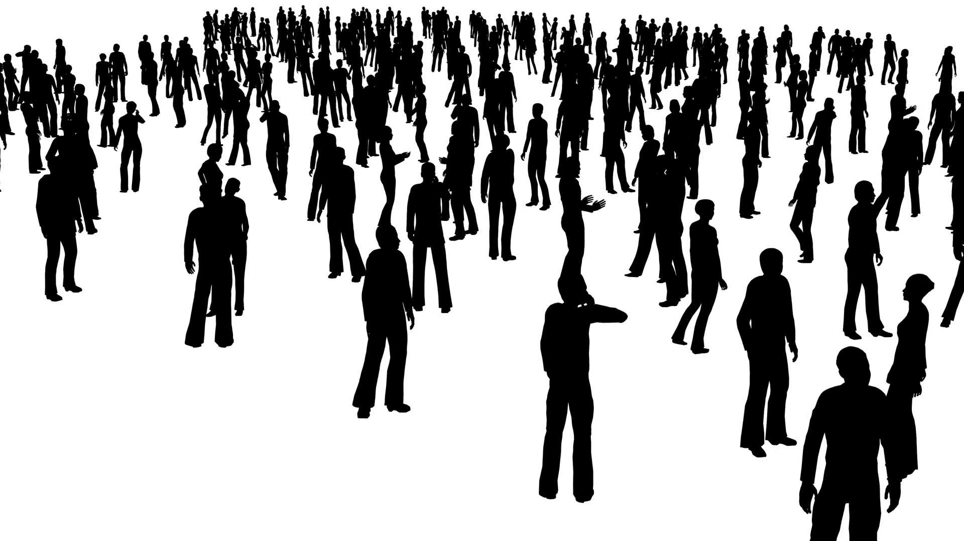
What is pedestrian data?
Pedestrian data - data describing pedestrian behavior

Slide 4
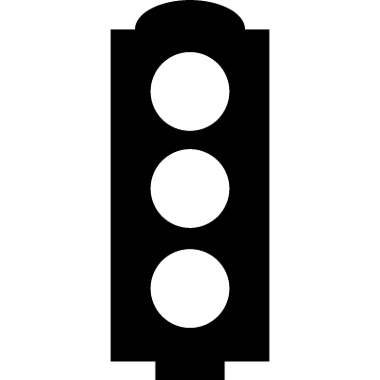


Applications of pedestrian data
Security
Robotics
Traffic control and optimization

Slide 5
Need for good pedestrian data
QUALITY
QUANTITY

Slide 6
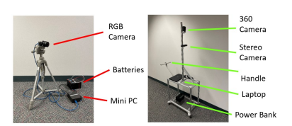
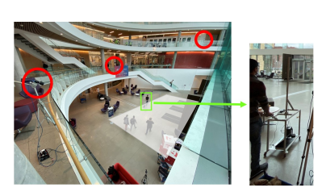
Described method of pedestrian data collection

Slide 7
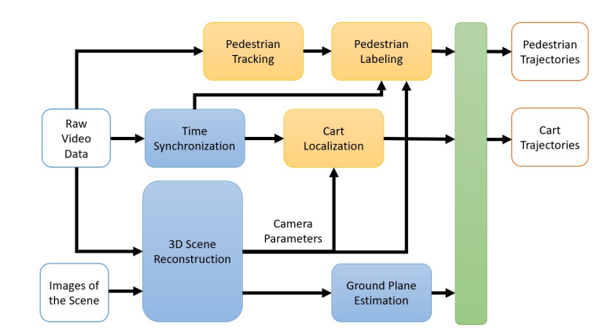
Described method of pedestrian data collection

Slide 8
Conclusion
Designed system allows collection of large amount of good quality pedestrian data
Cost of said system is relatively low
Overall quality of data is not dependent of time of collection, but quantity is

